Slide 1
GOOGLE MAPS V2
ucu-ccs

Slide 2
Google MAPS
The Google Maps API for Android offers some simple ways for you to add shapes to your maps in order to customize them for your application.
ucu-ccs

Slide 3
Polyline
The Polyline class defines a set of connected line segments on the map. A Polyline object consists of a set of LatLng locations, and creates a series of line segments that connect those locations in an ordered sequence.
ucu-ccs

Slide 4
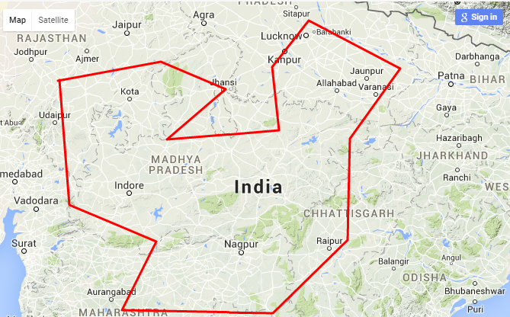
ucu-ccs

Slide 5
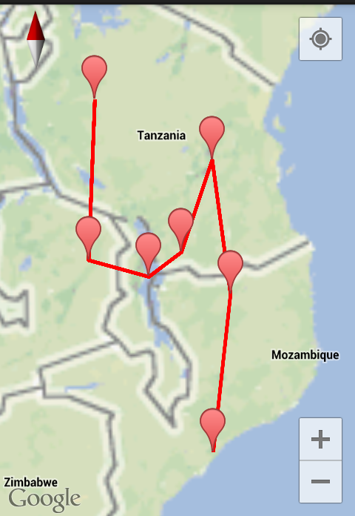

Slide 6
Properties of Polyline
Points or add
The vertices of the line. Line segments are drawn between consecutive points. A polyline is not closed by default; to form a closed polyline, the start and end points must be the same.
Sample Code
.add(new LatLng(-37.81319, 144.96298), new LatLng(-31.95285, 115.85734))
ucu-ccs

Slide 7
Properties of Polyline
Width
Line segment width in screen pixels. The width is constant and independent of the camera's zoom level. The default value is 10.
Sample Code
.width(10)
Note: The parameter is only integer
ucu-ccs

Slide 8
Properties of Polyline
Color
Line segment color in ARGB format, the same format used by Color
Sample Code
.color(Color.Blue)
ucu-ccs

Slide 9
Polyline Code
mMap.addPolyline(new PolylineOptions() .add(new LatLng(-37.81319, 144.96298), new LatLng(-31.95285, 115.85734)) .width(10) .color(Color.BLUE));
ucu-ccs

Slide 10
Polygons
Polygon objects are similar to Polyline objects in that they consist of a series of coordinates in an ordered sequence. However, instead of being open-ended, polygons are designed to define regions within a closed loop with the interior filled in.
ucu-ccs

Slide 11
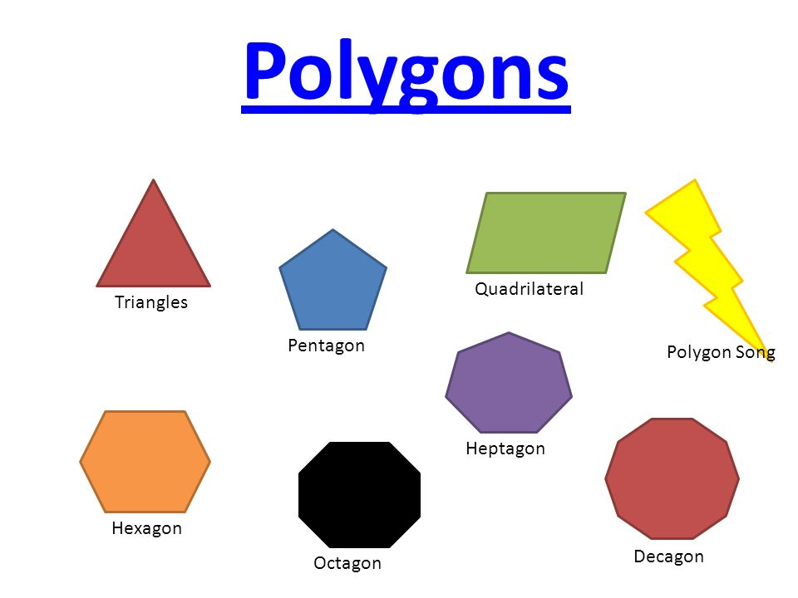
Normal People Polygon

Slide 12
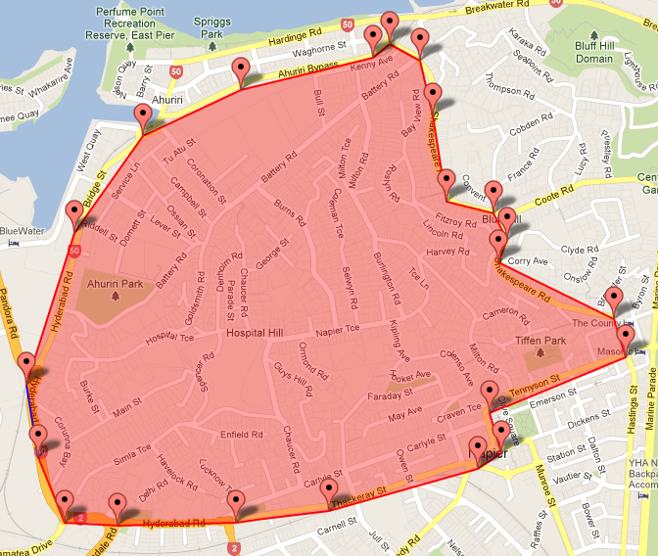
Polygon Google Map

Slide 13
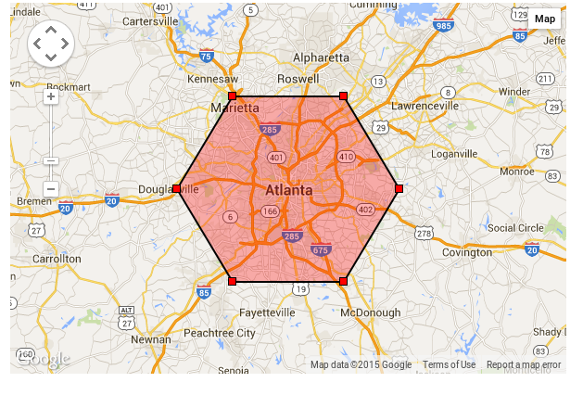
Polygon Google Map

Slide 14
Properties of Polygon
Points or add
The vertices of the line. Line segments are drawn between consecutive points. A polyline is not closed by default; to form a closed polyline, the start and end points must be the same.
Sample Code
.add(new LatLng(0, 0), new LatLng(0, 5), new LatLng(3, 5), new LatLng(0, 0))
ucu-ccs

Slide 15
Properties of Polyline
Stroke Color
Line segment color in ARGB format, the same format used by Color.
Sample Code
.strokeColor(Color.Red)
ucu-ccs

Slide 16
Properties of Polyline
Fill Color
Fill color in ARGB format, the same format used by Color. The default value is transparent (0x00000000).
Sample Code
.fillColor(Color.argb(128, 255, 0, 0))
ucu-ccs

Slide 17
Polygons Code
mMap.addPolygon(new PolygonOptions() .add(new LatLng(0, 0), new LatLng(0, 5), new LatLng(3, 5), new LatLng(0, 0)) .strokeColor(Color.RED) .fillColor(Color.argb(128, 255, 0, 0));
ucu-ccs

Slide 18
Circles
In addition to a generic Polygon class, the Maps API also includes specific classes for Circles to simplify their construction.
To construct a circle, you must specify the following two properties:
center as a LatLng.
radius in meters.
ucu-ccs

Slide 19
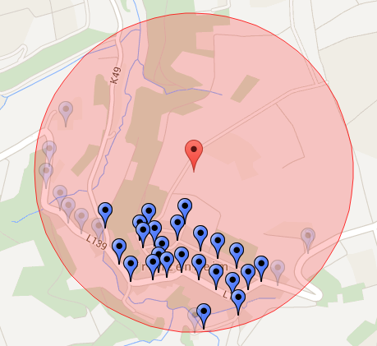
Circle
Radius of the Circle
100meters
Center of the Circle

Slide 20
Properties of Circle
Center
The center of the Circle is specified as a LatLng.
Sample Code
.center(new LatLng(37.4, -122.1))
ucu-ccs

Slide 21
Properties of Circle
Radius
The radius of the circle, specified in meters. It should be zero or greater..
Sample Code
.radius(1000)
1 meter == 1000
ucu-ccs

Slide 22
Properties of Circle
Stroke Width
The radius of the circle, specified in meters. It should be zero or greater..
Sample Code
.strokeWidth(10)
ucu-ccs

Slide 23
Properties of Circle
Stroke Color
The color of the circle outline in ARGB format, the same format used by Color.
Sample Code:
.strokeColor(Color.Green)
ucu-ccs

Slide 24
Properties of Circle
Fill Color
The color of the circle fill in ARGB format, the same format used by Color.
Sample Code:
.fillColor(Color.argb(128, 255, 0, 0))
ucu-ccs

Slide 25
Circles
mMap.addCircle(new CircleOptions() .center(new LatLng(37.4, -122.1)) .radius(1000) .strokeWidth(10) .strokeColor(Color.GREEN) .fillColor(Color.argb(128, 255, 0, 0)) .clickable(true));
ucu-ccs

Slide 26
Ground Overlays
A ground overlay is a scalable image that is fixed to a map.
A ground overlay has the following properties: Position, Image , Bearing, zIndex, Transparency, Visibility
ucu-ccs

Slide 27
Ground Overlays
LatLng ucu = new LatLng(15.97970995, 120.56076229) BitmapDescriptor image = BitmapDescriptorFactory.fromResource(R.drawable.ucu_logo); float width = 100; float height = 100; GroundOverlay groundOverlay = mMap.addGroundOverlay(new GroundOverlayOptions() .image(image) .position(ucu,width,height) .transparency((float) 0.5)); mMap.moveCamera(CameraUpdateFactory.newLatLngZoom(ucu, 17.0f));
ucu-ccs

Slide 28
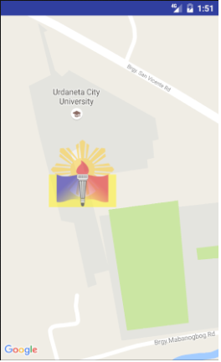
ucu-ccs

Slide 29
Change an Overlay
You can change the ground overlay image after it's been added to the map with the
GroundOverlay imageOverlay = mMap.addGroundOverlay(LatLang); imageOverlay = mMap.setImage(BitmapDescriptorFactory.fromResource(R.drawable.ucu_logo));
ucu-ccs

Slide 30
Map types
Normal
Typical road map. Shows roads, some features built by humans, and important natural features like rivers. Road and feature labels are also visible.
Hybrid
Satellite photograph data with road maps added. Road and feature labels are also visible.
ucu-ccs

Slide 31
Map types
Satellite
Satellite photograph data. Road and feature labels are not visible.
Terrain
Topographic data. The map includes colors, contour lines and labels, and perspective shading. Some roads and labels are also visible.
ucu-ccs

Slide 32
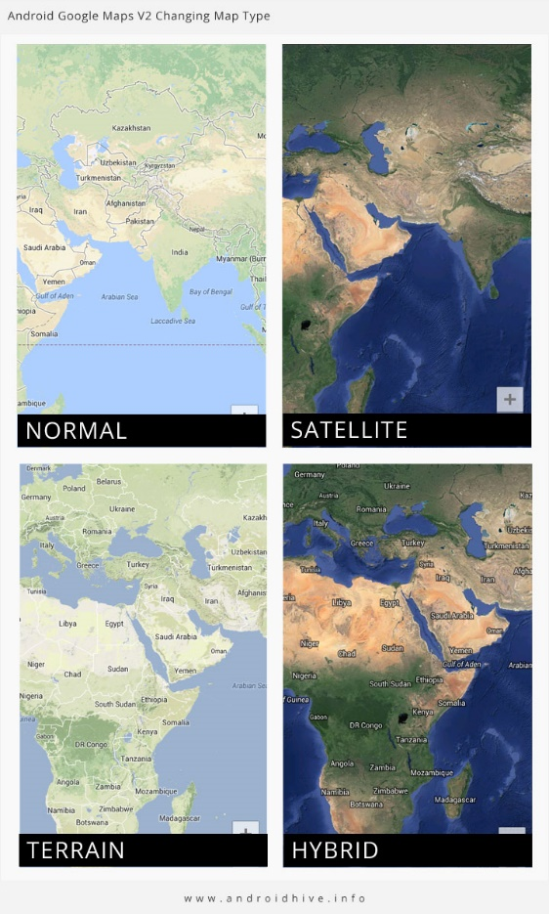
Map types
ucu-ccs

Slide 33
Map types
ucu-ccs

Slide 34
Map types
GoogleMap map; map.setMapType
(GoogleMap.MAP_TYPE_HYBRID);
ucu-ccs

